Slide 2
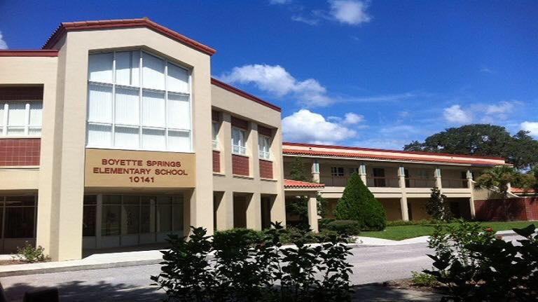
Welcome Parents We are excited to welcome your child to Kindergarten!

Slide 3
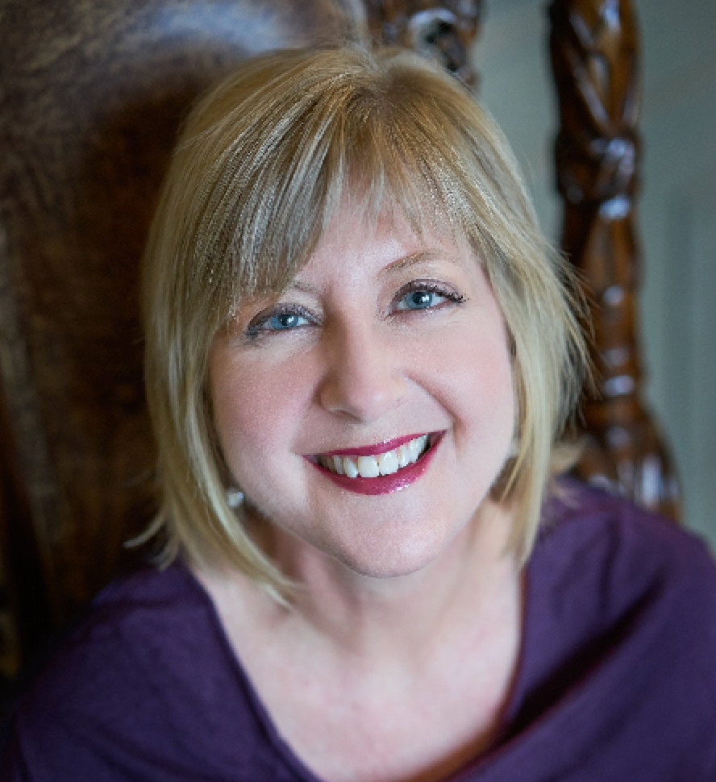
Jennifer McCrystal Principal
Elisa Walker
Assistant Principal

Slide 4
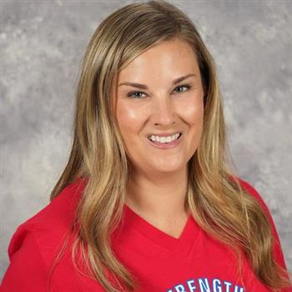
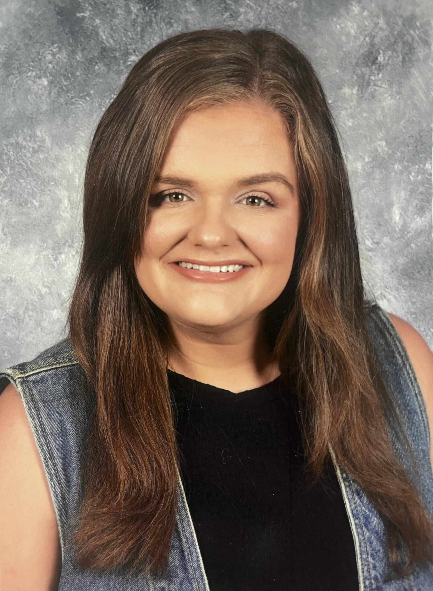
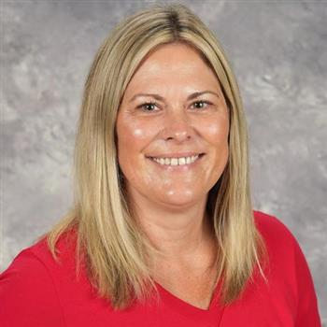
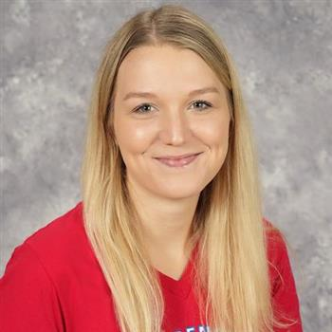
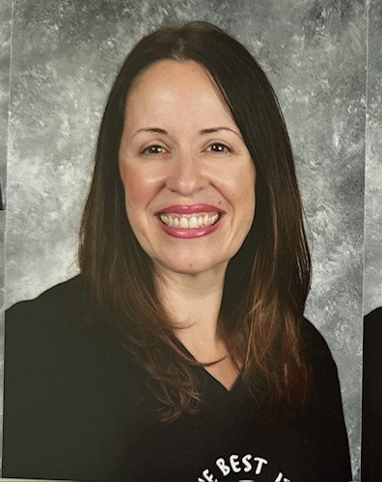
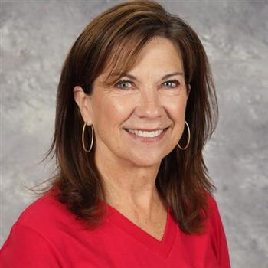
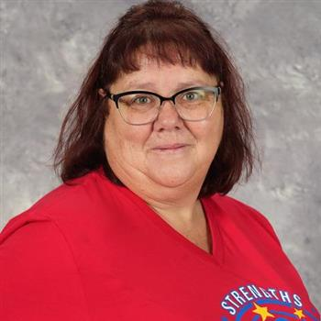
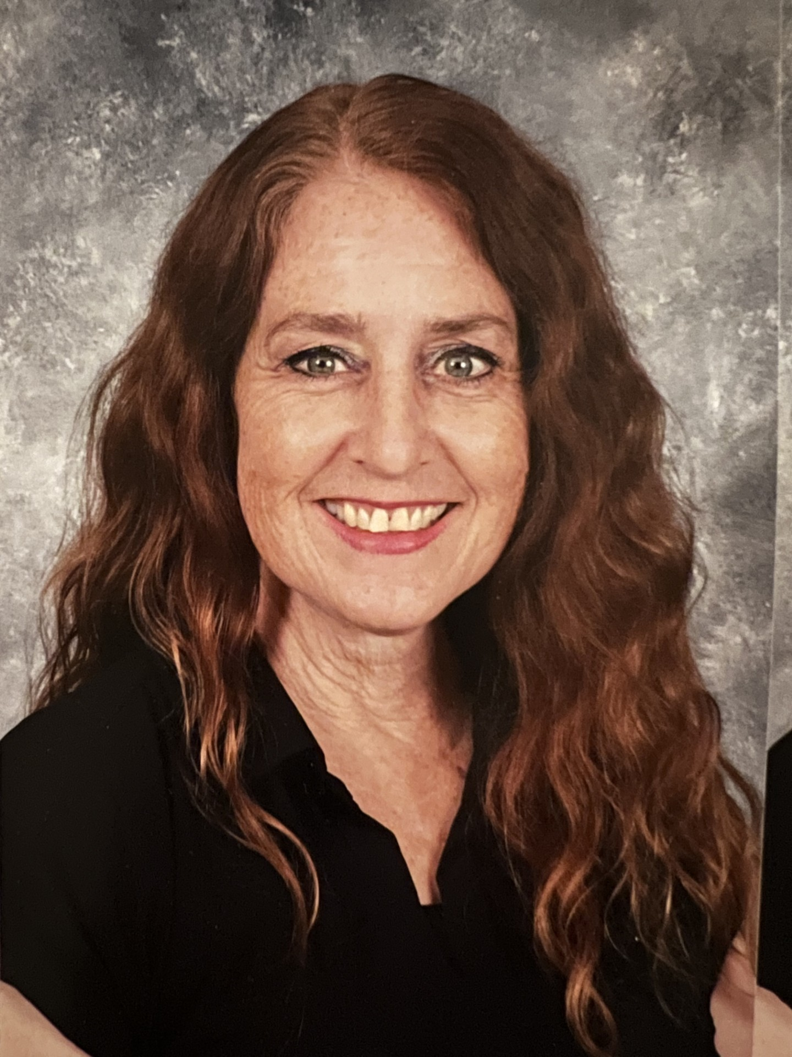
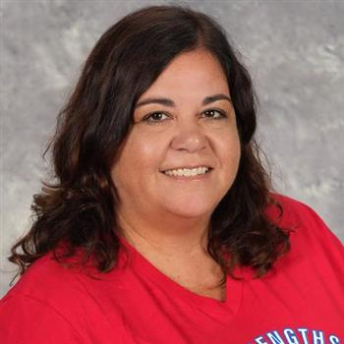
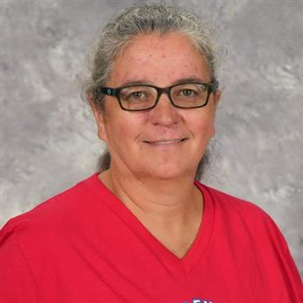
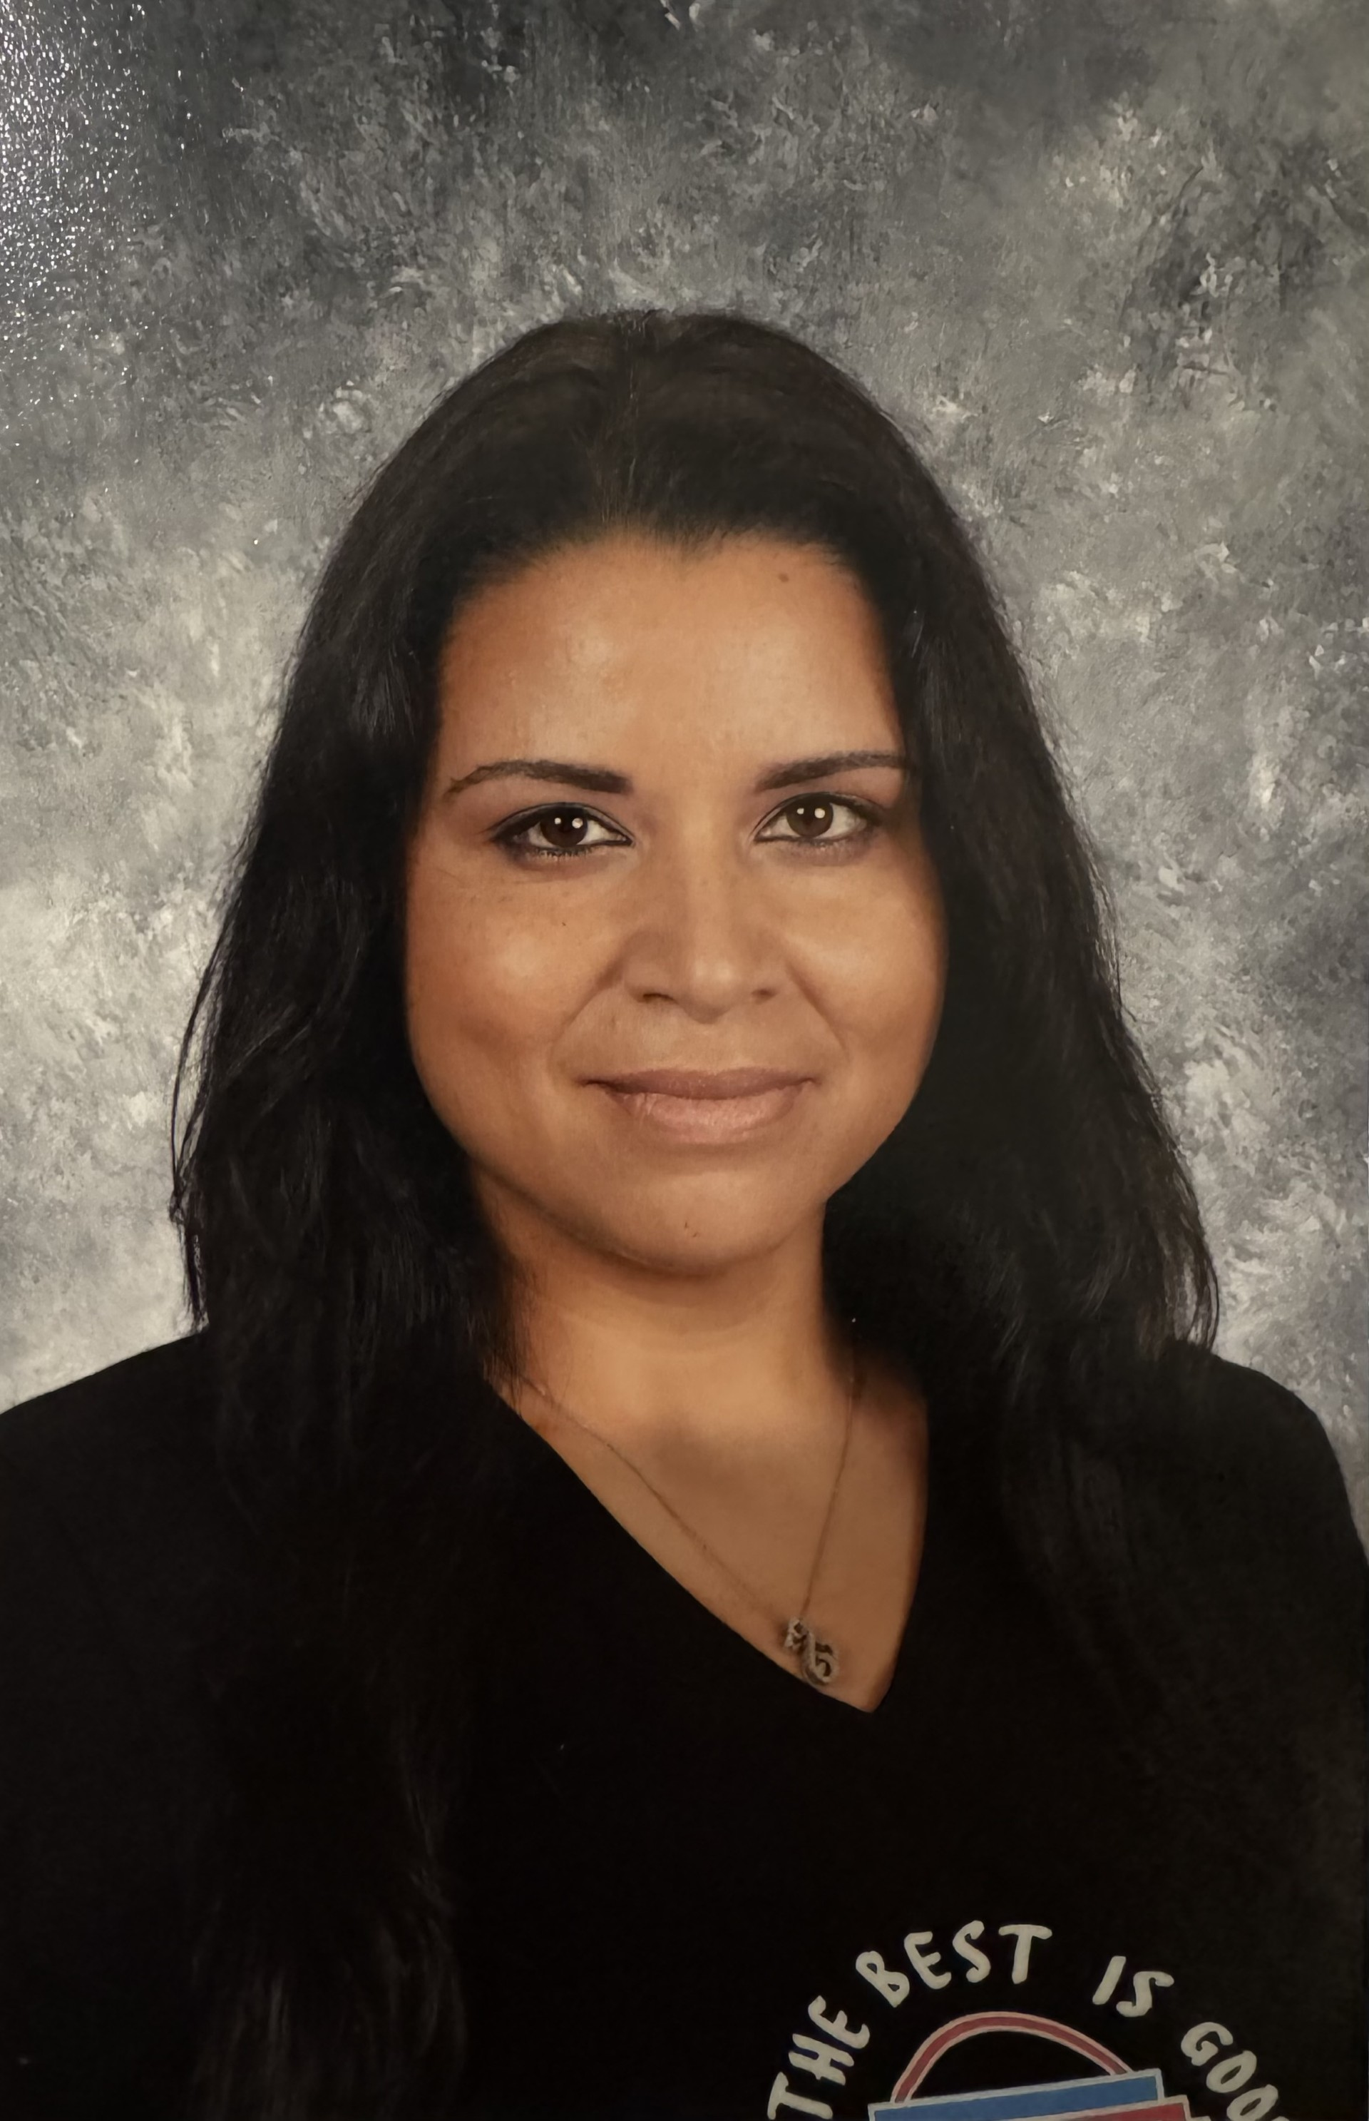
Meet our K Team
Lindsey Fohrer Corinne Cole
Rebecca Baker Anna Dill Carla Casey Casey
Suzzanne Horton Cristina Wride Carrie Howe
Bailey Sweeney
Pauline Barry Evelyn Suarez

Slide 5
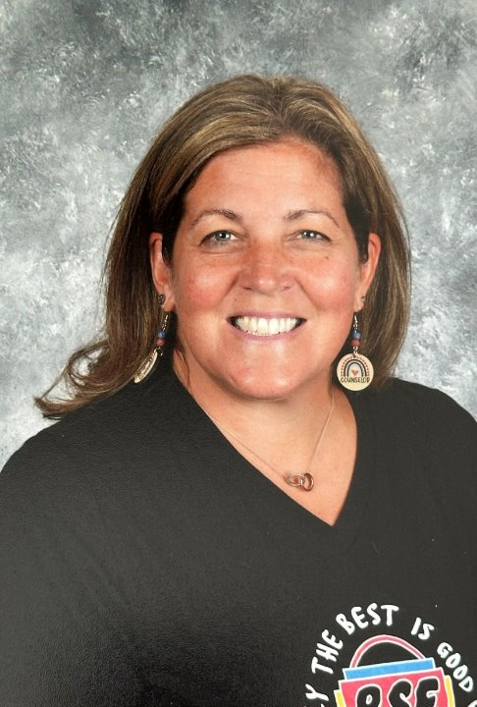
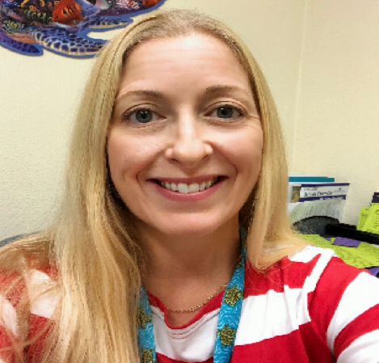
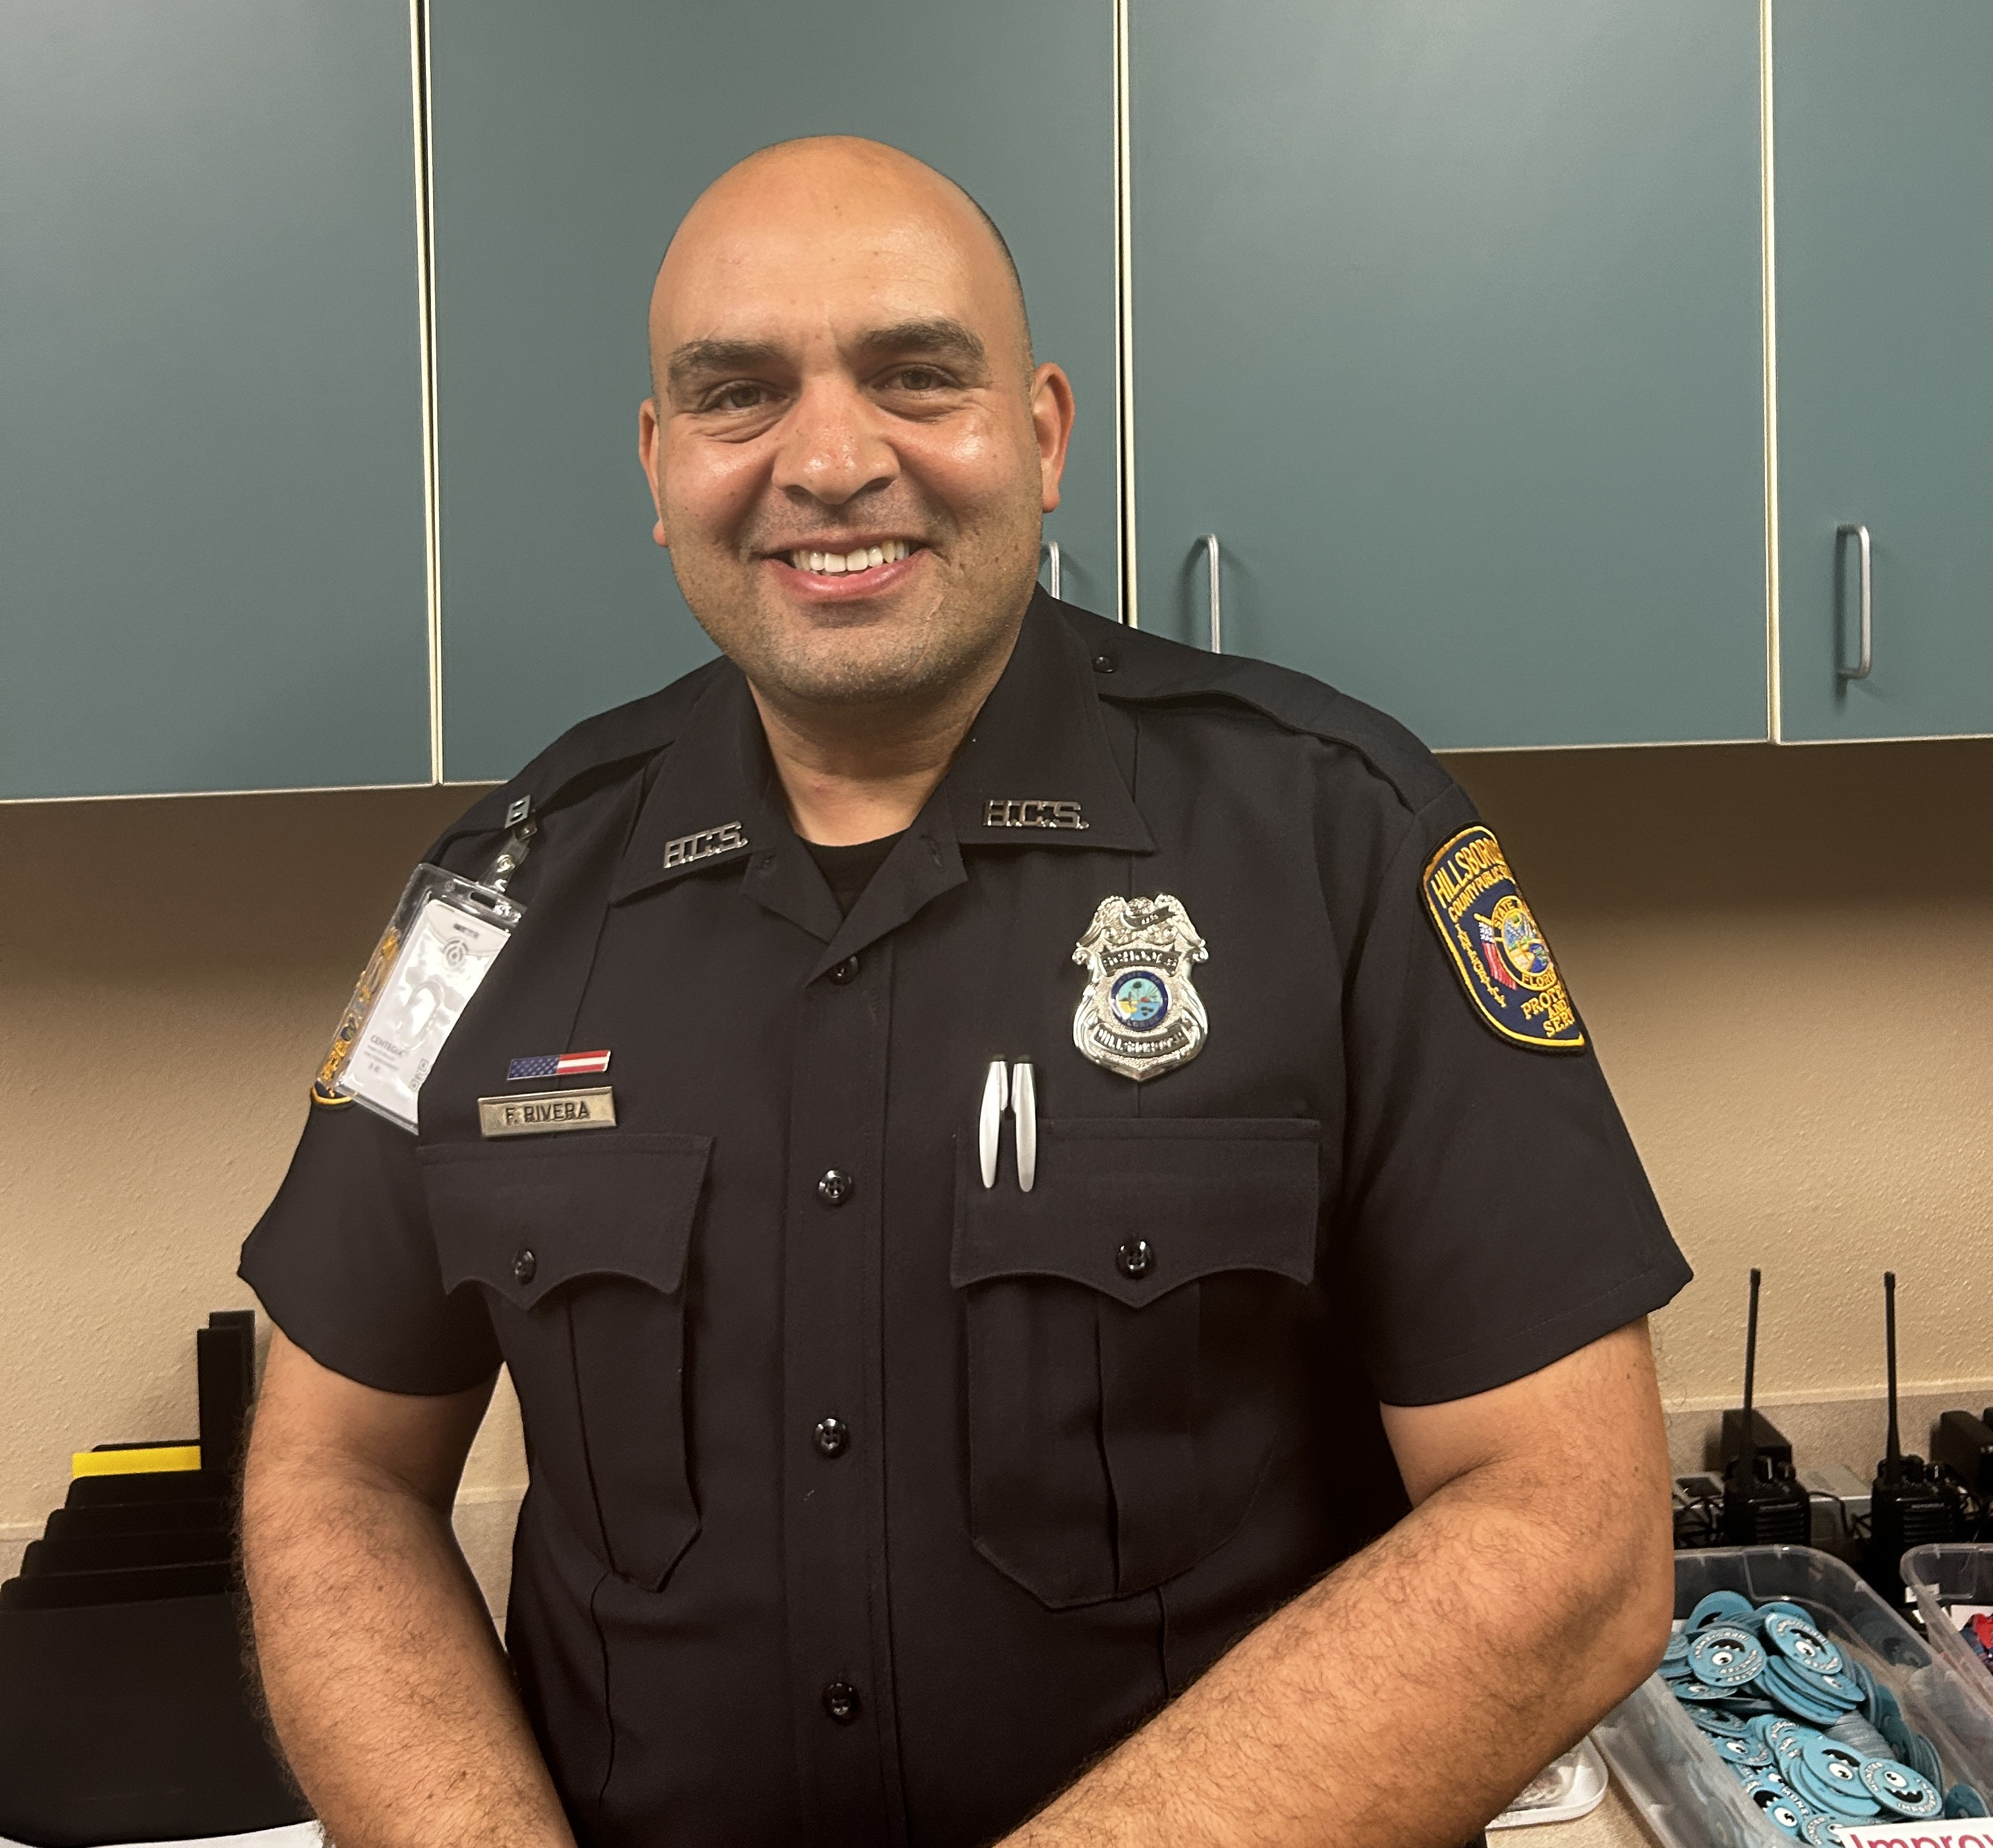
Guidance Department Mrs. Ramos Mrs.Flannigan Mrs. Wohlwend SRO Media Specialist Officer Rivera Mrs. Charbeneau

Slide 6
Steps to Enrollment with Mrs. June Hall
A parent/legal guardian must complete the registration process and provide the proper documents to the school site where the child will attend.
Your child can attend kindergarten next August as long as they turn 5 on or before September 1.
Your child is zoned for a particular elementary school based on your address. Find your assigned school at http://gis.sdhc.k12.fl.us/schoollocator/.
For parents who wish to send their child to a school outside of their zoned area, see our choice options at https://www.hillsboroughschools.org/choice.
Notes:
Early Childhood Programs and Kindergarten web page: https://hillsboroughschools.org/doc/2276/bold-beginnings/kindergarten/kindergartenreg/

Slide 7
Documents needed for enrollment
What forms do I need to compete?
Student Enrollment Record Form - SER (provided at the school site or electronically)
Student Residency Form – can be completed ahead of time, supporting documentation is required

Slide 8
Documents needed for enrollment (Continued)
What supporting documents do I need to register for kindergarten?
Birth certificate
Social security card, if available
Florida Physical HRS Form -- Florida Physical HRS form supplied by a doctor dated within 12 months prior to entry in Florida Schools (first day of school)
Florida Immunization Record on HRS hard card (form #680) supplied by a doctor
Two forms of verification of address that prove where you live but are NOT your driver’s license or state-issued ID card (some examples are a utility bill, lease, or a contract to purchase a home)
If a child lives with someone who is not a parent, you may also need to complete a student resident form, which is available at the school
Notes:
Kindergarten Registration Checklist – English: https://hillsboroughschools.org/docs/00/00/22/76/K_Reg_Checklist.pdf
Kindergarten Registration Checklist – Spanish: https://hillsboroughschools.org/docs/00/00/22/76/K_Reg_ChecklistSP.pdf

Slide 9
Important Information
School Lunch Program
Online Registration: https://www.sdhc.k12.fl.us/doc/list/student-nutrition-services/free-reduced-lunch-application/53-648/
HOST Afterschool Care- AM and PM
Online Registration: https://www.hillsboroughschools.org/Domain/2453
Bus Information
District will send information prior to the start of school.
KG students must have an adult present to drop them off and pick them up from the bus stop.
Arrival and Dismissal Procedures
More info to come
Health Conditions (medication/food allergies)
Please contact the front office regarding any medical information and to
turn in paperwork and immunization information.
Notes:
Lunch Program Application: https://www.sdhc.k12.fl.us/doc/list/student-nutrition-services/free-reduced-lunch-application/53-648/
HOST

Slide 10
Summer VPK TBD
Florida's Voluntary Prekindergarten Program (VPK)
All of Florida's four-year-olds have access to free, quality prekindergarten programs.
https://www.sdhc.k12.fl.us/doc/list/early-childhood-programs-and-kindergarten/voluntary-
FREE Summer program to ensure kindergarten readiness (dates and times to be determined)
Approximately 20 sites throughout the district (sites to be determined)
Registration requirements: proof of birth, proof of residence and a shot record
Child must be eligible to start kindergarten in August 2025
(5 by September 1, 2025)
Child may not have attended a school-year VPK
In Region 5 these following schools are open for VPK:
Schools TBD: Dates: TBD Time:7:00-5:30
Notes:
Follow our Ready for Kindergarten monthly checklist to make sure your child is ready for Kindergarten!
https://hillsboroughschools.org/docs/00/00/24/24/CountdownKindergartenChecklist.pdf

Slide 11
Steps to be ready!
Cognitive - Ready to Read
Knowledge of letters & sounds, numbers, ability to focus on tasks
Social
Plays well with others, shares, resolves conflicts with words
Opportunities to play with other children, sports, park

Slide 12
Steps to be ready!
Physical
Throwing, skipping, monkey bars
Use pencils, pens, markers, cutting with safety scissors, tweezers, & buttoning
Opening and closing lunch items (juice, snack bags, etc.)
Emotional
Self-control, avoids melt downs, able to wait for a turn, comfortable with new environments and with new people
Visit a variety of places like libraries, museums, future school

Slide 13
Steps to be ready!
Prepare your child for the role of “student”
Behavior that promotes learning
Participation in the classroom family
Active listening throughout the day
Responsibility (getting work done)
Independence
Effort
Self-sufficiency in the restroom
Self-sufficiency at lunch
*Check out our Getting Ready for Kindergarten table before you leave today! *
Notes:
Florida’s Office of Early Learning Development Standards document – Birth to Kindergarten: http://flbt5.floridaearlylearning.com/docs/OEL-SR15BtoK.pdf

Slide 14
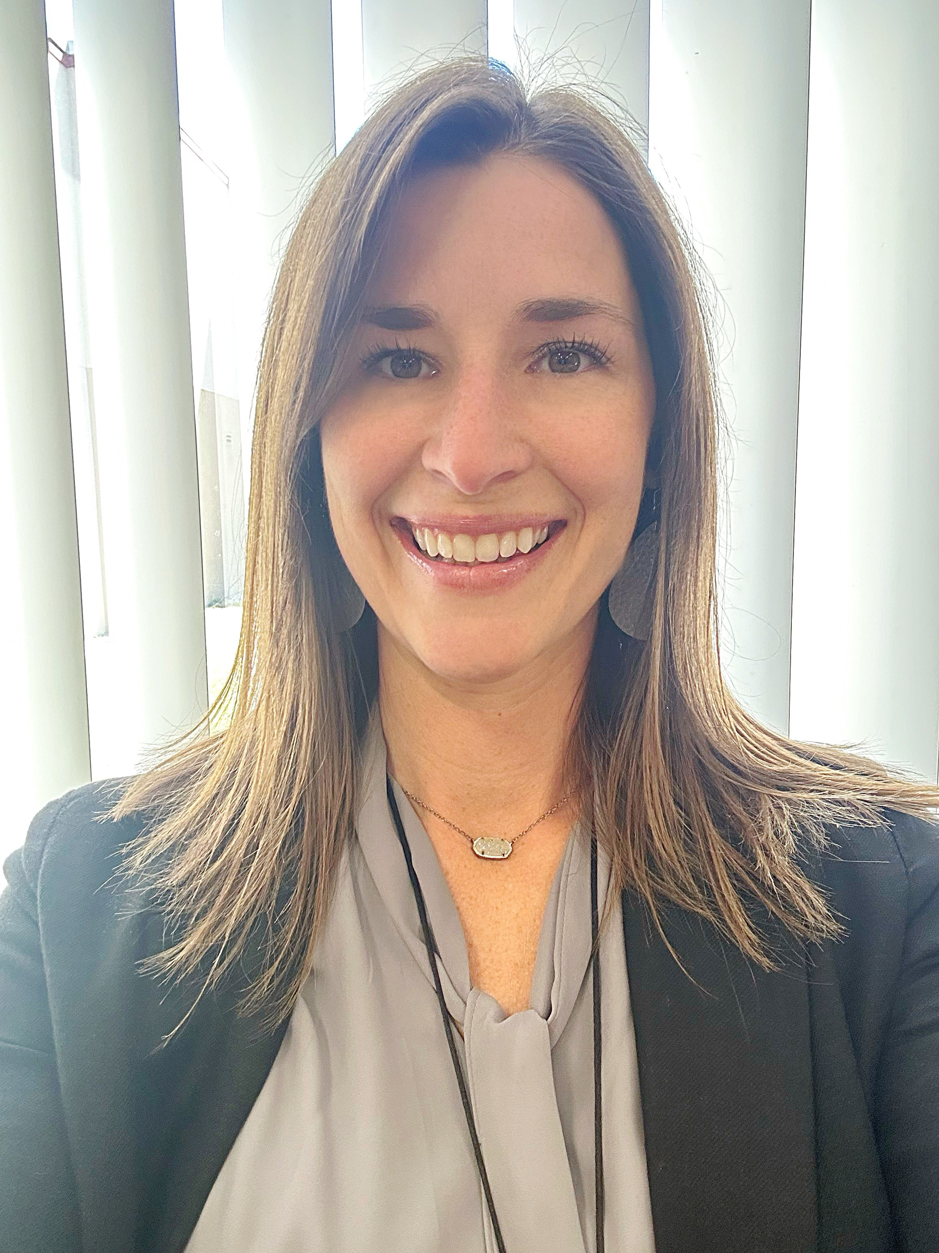
Mrs. Nicosia Gifted Lead Teacher Kindergarten and Gifted At BSE there are several opportunities for your child to be challenged and enriched in their classroom. Students that are identified as gifted in kindergarten receive gifted enrichment services during the week with our Boyette Springs Gifted Teacher. Our Center for Gifted Studies is a separate CHOICE program that begins in First Grade If you think your child might have gifted traits or want further information you can look on our school's website or reach out to Mrs. Nicosia, Gifted Lead Teacher CHOICE Programs If you are not currently zoned for Boyette Springs Elementary and are interested in joining us for kindergarten, please visit the Hillsborough County Website that has information on how to apply for the CHOICE lottery system.

Slide 15
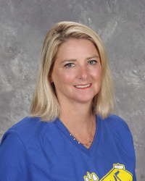
Andrea Kilkenny School Clinic Information
Ellen Ackerman
Entry Vaccinations and Physicals
Medications
Allergies
-Diet RX Form
Hearing and Vision Screenings

Slide 16
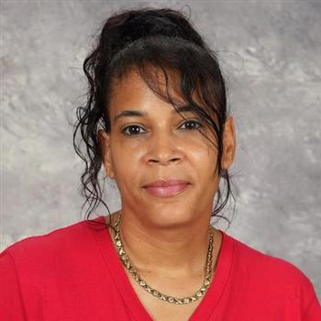
Ms. Maria Flores Cafeteria Manager
Student numbers
Universal breakfast is free for all students. Served between 7:10-7:40 am.
Free and Reduced Lunch- forms are available upon registration. Online registration is available.
Current lunch price is $2.25

Slide 17
Resources
VROOM.org
Vroom is a global program of the Bezos Family Foundation. FREE, science-based tips and tools help parents and caregivers give children a great start in life today—and an even better future.
PBSkids.org
PBS KIDS is here to help no matter what learning situation your family is facing this year. Every week, we’ll provide a new at-home learning topic with activities, games, and articles — featuring your favorite PBS KIDS characters like Daniel Tiger, Elmo, and the Kratt brothers — to keep your child learning through play.
Florida's Office of Early Learning
Development Standards document-Birth to Kindergarten:
https://bit.ly/KindergartenReadyChecklist

Slide 18
Kindergarten Supply List
Full sized backpack- no wheels
1 pair of blunt tip scissors
3 boxes of 24 count crayons
3 composition notebooks
1 primary writing composition notebook
1 zippered pencil pouch
2 (plastic) prong folders with pockets
24 yellow pencils
4 regular dry erase markers (black)
1 inch binder (one-any color)
Complete change of clothes (pants, shirt, socks, and undies)
Headphones (to be kept at school, not earbuds)

Slide 19
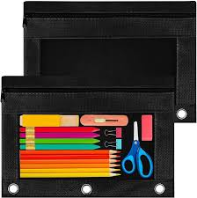
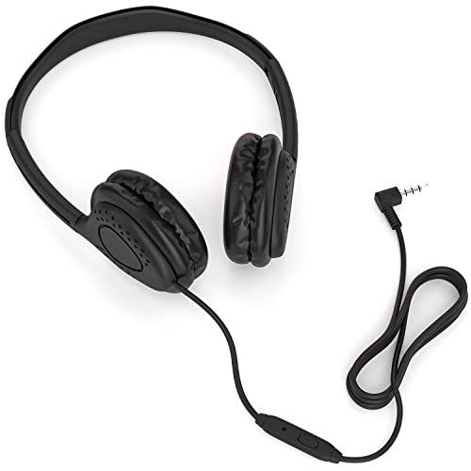
Supplies
Primary Writing Notebook Zippered Fabric Pencil Pouch Headphones (no earbuds)
1 per student 9.8 x7 wired plug
Composition Notebook 1 in Binder with Black Dry Erase Markers
3 per student Clear View Front Cover

Slide 20
Important Contact Information
School Phone Number: 813-671-5060
School Email Address: boyettesprings.elementary@hcps.net
School Website: https://www.hillsboroughschools.org/boyettesprings
School Hours:
Free Breakfast 7:10-7:40 Instruction begins at 7:40am
Monday- Early Release Dismissal 12:55pm
Tuesday – Friday Dismissal 1:55pm

Slide 21
Questions?

